Slide 1

Latent Variable Analysis in R Made easy
John Kitchener Sakaluk
University of Victoria
Department of Psychology

Slide 2

Who Am I? (@JohnSakaluk)
New faculty/stats instructor
Statistics Consultant for CJHS and JSR
Longtime stats-geek
7-year anniversary w/ factor-analysis
Graduate stats minor (8 grad classes, multiple workshops)
Writes stats/methods blogs and articles
Self-taught R-user (~3-4 years)

Slide 3

About These Workshop Materials

Slide 4
Why Are We Using R
Because it is your favourite price (free)
Because it is increasingly popular
Because it can do virtually everything
EFA
CFA
SEM
IRT
LCA
Because it is becoming more user friendly
Because it is reproducible
Because it makes beautiful visualizations

Slide 5
Need Convincing? SPSS vs R for Parallel Analysis
set mxloops=9000 printback=off width=80 seed = 1953125.matrix.* Enter the name/location of the data file for analyses after "FILE ="; If you specify "FILE = *", then the program will read the current, active SPSS data file; Alternatively, enter the name/location of a previously saved SPSS data file instead of "*"; you can use the "/ VAR =" subcommand after "/ missing=omit" subcommand to select variables for the analyses.GET raw / FILE = * / missing=omit / VAR = y1 to y6.* Enter the desired number of parallel data sets here.compute ndatsets = 100.* Enter the desired percentile here.compute percent = 95.* Enter either 1 for principal components analysis, or 2 for principal axis/common factor analysis.compute kind = 2 .* Enter either 1 for normally distributed random data generation parallel analysis, or 2 for permutations of the raw data set.compute randtype = 2.****************** End of user specifications. ******************compute ncases = nrow(raw). compute nvars = ncol(raw).* principal components analysis & random normal data generation.do if (kind = 1 and randtype = 1).compute nm1 = 1 / (ncases-1).compute vcv = nm1 * (sscp(raw) - ((t(csum(raw))*csum(raw))/ncases)).compute d = inv(mdiag(sqrt(diag(vcv)))).compute realeval = eval(d * vcv * d).compute evals = make(nvars,ndatsets,-9999).loop #nds = 1 to ndatsets.compute x = sqrt(2 * (ln(uniform(ncases,nvars)) * -1) ) &* cos(6.283185 * uniform(ncases,nvars) ).compute vcv = nm1 * (sscp(x) - ((t(csum(x))*csum(x))/ncases)).compute d = inv(mdiag(sqrt(diag(vcv)))).compute evals(:,#nds) = eval(d * vcv * d).end loop.end if.* principal components analysis & raw data permutation.do if (kind = 1 and randtype = 2).compute nm1 = 1 / (ncases-1).compute vcv = nm1 * (sscp(raw) - ((t(csum(raw))*csum(raw))/ncases)).compute d = inv(mdiag(sqrt(diag(vcv)))).compute realeval = eval(d * vcv * d).compute evals = make(nvars,ndatsets,-9999).loop #nds = 1 to ndatsets.compute x = raw.loop #c = 1 to nvars.loop #r = 1 to (ncases -1).compute k = trunc( (ncases - #r + 1) * uniform(1,1) + 1 ) + #r - 1.compute d = x(#r,#c).compute x(#r,#c) = x(k,#c).compute x(k,#c) = d.end loop.end loop.compute vcv = nm1 * (sscp(x) - ((t(csum(x))*csum(x))/ncases)).compute d = inv(mdiag(sqrt(diag(vcv)))).compute evals(:,#nds) = eval(d * vcv * d).end loop.end if.* PAF/common factor analysis & random normal data generation.do if (kind = 2 and randtype = 1).compute nm1 = 1 / (ncases-1).compute vcv = nm1 * (sscp(raw) - ((t(csum(raw))*csum(raw))/ncases)).compute d = inv(mdiag(sqrt(diag(vcv)))).compute cr = (d * vcv * d).compute smc = 1 - (1 &/ diag(inv(cr)) ).call setdiag(cr,smc).compute realeval = eval(cr).compute evals = make(nvars,ndatsets,-9999).compute nm1 = 1 / (ncases-1).loop #nds = 1 to ndatsets.compute x = sqrt(2 * (ln(uniform(ncases,nvars)) * -1) ) &* cos(6.283185 * uniform(ncases,nvars) ).compute vcv = nm1 * (sscp(x) - ((t(csum(x))*csum(x))/ncases)).compute d = inv(mdiag(sqrt(diag(vcv)))).compute r = d * vcv * d.compute smc = 1 - (1 &/ diag(inv(r)) ).call setdiag(r,smc).compute evals(:,#nds) = eval(r).end loop.end if.* PAF/common factor analysis & raw data permutation.do if (kind = 2 and randtype = 2).compute nm1 = 1 / (ncases-1).compute vcv = nm1 * (sscp(raw) - ((t(csum(raw))*csum(raw))/ncases)).compute d = inv(mdiag(sqrt(diag(vcv)))).compute cr = (d * vcv * d).compute smc = 1 - (1 &/ diag(inv(cr)) ).call setdiag(cr,smc).compute realeval = eval(cr).compute evals = make(nvars,ndatsets,-9999).compute nm1 = 1 / (ncases-1).loop #nds = 1 to ndatsets.compute x = raw.loop #c = 1 to nvars.loop #r = 1 to (ncases -1).compute k = trunc( (ncases - #r + 1) * uniform(1,1) + 1 ) + #r - 1.compute d = x(#r,#c).compute x(#r,#c) = x(k,#c).compute x(k,#c) = d.end loop.end loop.compute vcv = nm1 * (sscp(x) - ((t(csum(x))*csum(x))/ncases)).compute d = inv(mdiag(sqrt(diag(vcv)))).compute r = d * vcv * d.compute smc = 1 - (1 &/ diag(inv(r)) ).call setdiag(r,smc).compute evals(:,#nds) = eval(r).end loop.end if.* identifying the eigenvalues corresponding to the desired percentile.compute num = rnd((percent*ndatsets)/100).compute results = { t(1:nvars), realeval, t(1:nvars), t(1:nvars) }.loop #root = 1 to nvars.compute ranks = rnkorder(evals(#root,:)).loop #col = 1 to ndatsets.do if (ranks(1,#col) = num).compute results(#root,4) = evals(#root,#col).break.end if.end loop.end loop.compute results(:,3) = rsum(evals) / ndatsets.print /title="PARALLEL ANALYSIS:".do if (kind = 1 and randtype = 1).print /title="Principal Components & Random Normal Data Generation".else if (kind = 1 and randtype = 2).print /title="Principal Components & Raw Data Permutation".else if (kind = 2 and randtype = 1).print /title="PAF/Common Factor Analysis & Random Normal Data Generation".else if (kind = 2 and randtype = 2).print /title="PAF/Common Factor Analysis & Raw Data Permutation".end if.compute specifs = {ncases; nvars; ndatsets; percent}.print specifs /title="Specifications for this Run:" /rlabels="Ncases" "Nvars" "Ndatsets" "Percent".print results /title="Raw Data Eigenvalues, & Mean & Percentile Random Data Eigenvalues" /clabels="Root" "Raw Data" "Means" "Prcntyle" /format "f12.6".do if (kind = 2).print / space = 1.print /title="Warning: Parallel analyses of adjusted correlation matrices".print /title="eg, with SMCs on the diagonal, tend to indicate more factors".print /title="than warranted (Buja, A., & Eyuboglu, N., 1992, Remarks on parallel".print /title="analysis. Multivariate Behavioral Research, 27, 509-540.).".print /title="The eigenvalues for trivial, negligible factors in the real".print /title="data commonly surpass corresponding random data eigenvalues".print /title="for the same roots. The eigenvalues from parallel analyses".print /title="can be used to determine the real data eigenvalues that are".print /title="beyond chance, but additional procedures should then be used".print /title="to trim trivial factors.".print / space = 2.print /title="Principal components eigenvalues are often used to determine".print /title="the number of common factors. This is the default in most".print /title="statistical software packages, and it is the primary practice".print /title="in the literature. It is also the method used by many factor".print /title="analysis experts, including Cattell, who often examined".print /title="principal components eigenvalues in his scree plots to determine".print /title="the number of common factors. But others believe this common".print /title="practice is wrong. Principal components eigenvalues are based".print /title="on all of the variance in correlation matrices, including both".print /title="the variance that is shared among variables and the variances".print /title="that are unique to the variables. In contrast, principal".print /title="axis eigenvalues are based solely on the shared variance".print /title="among the variables. The two procedures are qualitatively".print /title="different. Some therefore claim that the eigenvalues from one".print /title="extraction method should not be used to determine".print /title="the number of factors for the other extraction method.".print /title="The issue remains neglected and unsettled.".end if.compute root = results(:,1).compute rawdata = results(:,2).compute percntyl = results(:,4).save results /outfile= 'screedata.sav' / var=root rawdata means percntyl .end matrix.* plots the eigenvalues, by root, for the real/raw data and for the random data; This command works in SPSS 12, but not in all earlier versions.GET file= 'screedata.sav'.TSPLOT VARIABLES= rawdata means percntyl /ID= root /NOLOG.
fa.parallel(dat, fm = "ml", fa = "fa", n.iter = 100, SMC = TRUE, show.legend = TRUE)

Slide 6
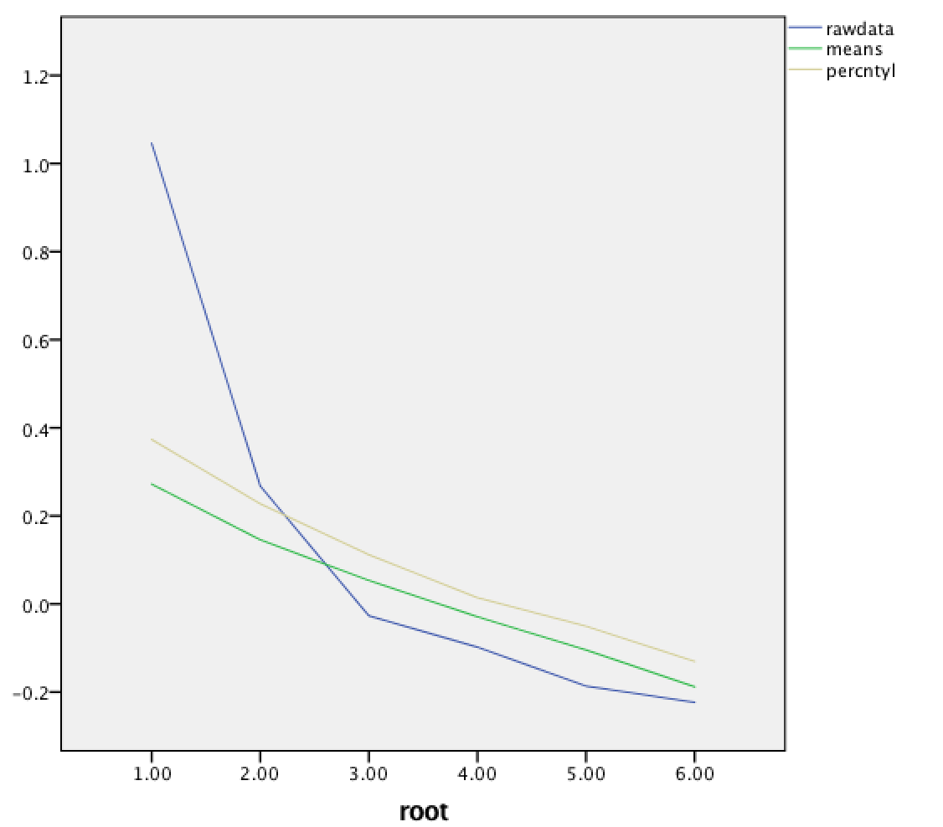
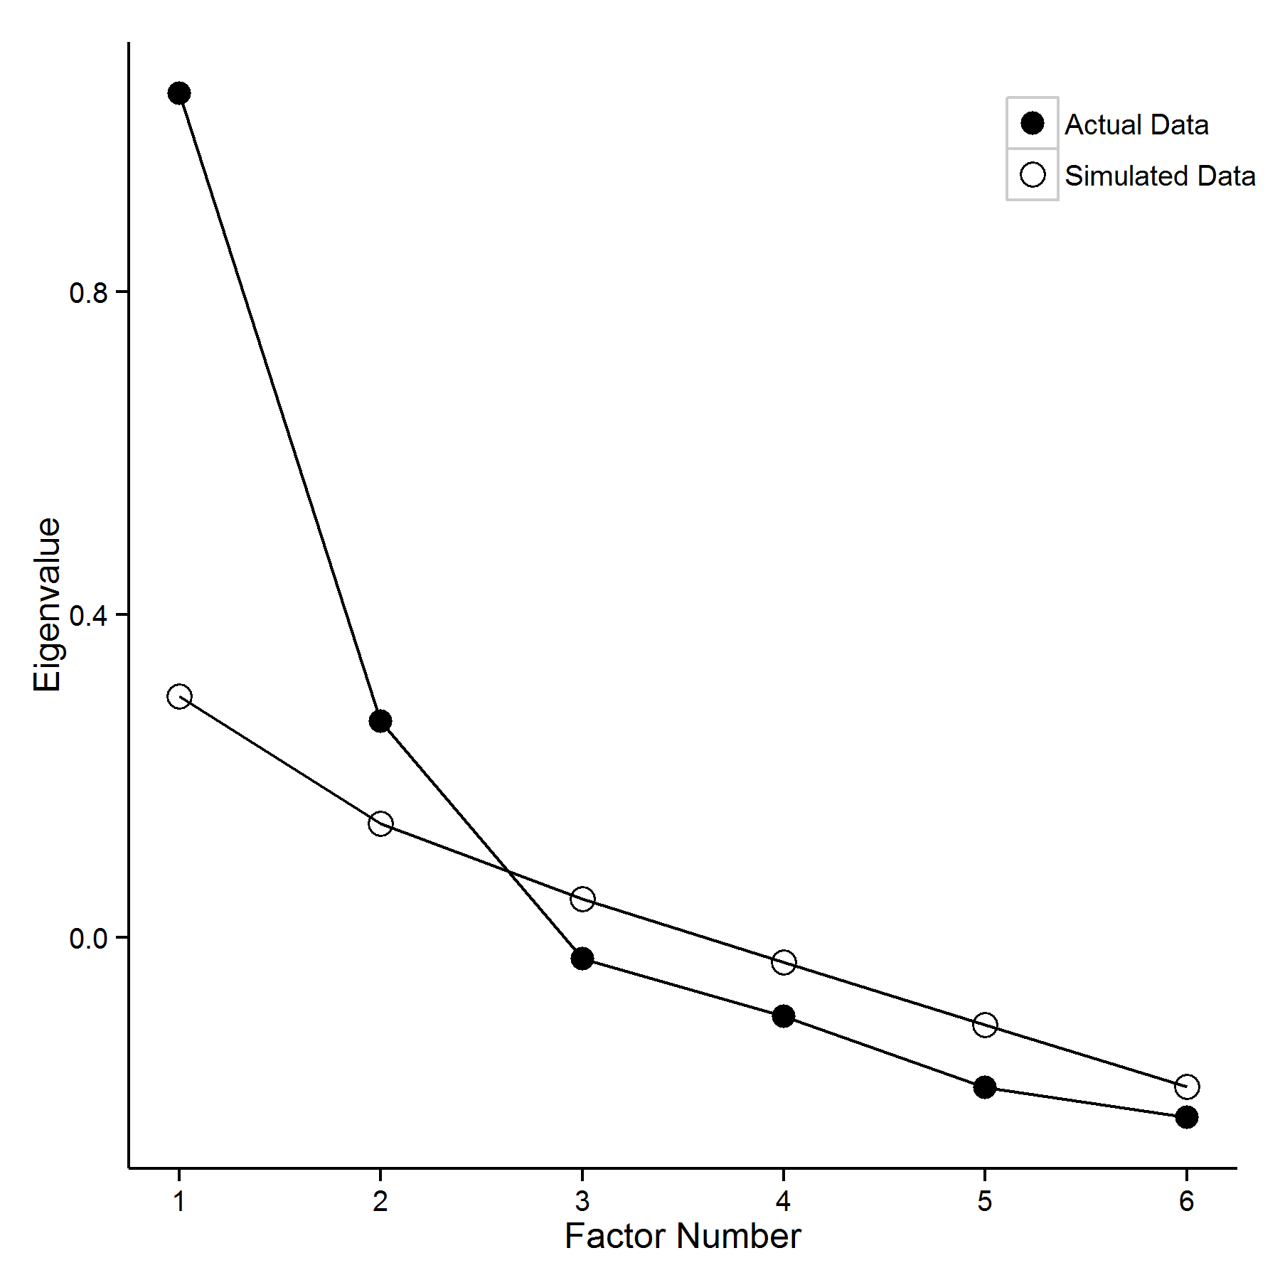
SPSS vs R for Parallel Analysis (plots)

Slide 7
Today’s Agenda
Orienting you to R (importing data, using packages)
Analytic steps in the “lifespan” of scale development
Preliminary theory testing w/ CFA (yes, CFA!)
Theory building w/ EFA
In-depth theory testing w/ CFA
Evaluating validity w/ SEM
Deeper/alternative understanding w/ IRT and LCA

Slide 8
An Orientation to R/R-Studio

Slide 9
Orienting You to R: Anatomy of an R Script
Operator that tells R to save output from function (on right of =) into object (named on left of =)
name = function(options)
Each function has flexibility; we need to specify how we want it to perform a certain task
(e.g., for t-test, level of alpha?, one-tailed or two-tailed?, using what variables/data?, etc.,)
We store information (e.g., data, output, plots) in objects—we need to give objects a name
Need to specify a function--what are we trying to do/create?
(e.g., import data, perform an EFA, create a plot of some sort)

Slide 10
Orienting You to R: Anatomy of an R Script (example)
Save the output of the read.csv function (data importing) into a new object called SSSS.dat
SSSS.dat = read.csv(file.choose())
There are a number of ways to “point” read.csv to a data file (e.g., an awful-looking file path).
The file.choose() option pulls up a navigation menu to make selecting data file *super* easy
The (arbitrary) name for our data file object; we will use it to refer to our data in later commands
The read.csv function is used to import data that is in a .csv file

Slide 11
Orienting You to R: Installing/Calling External Packages
install.packages (“package_name”)
Will automatically find/download/install external package on your computer.
Only need to do once, and then subsequent times will update.
library(package_name)
Tells R to make functions from an external package available for use.
Need to do this every time R restarts.

Slide 12
Check Out Section (1) of Script
See how comments/headings in R help to organize your code
Learn how to install/call packages, and request citation info to give developers credit
Import example data OR your own data

Slide 13
Step 1: Preliminary Theory-Testing with CFA

Slide 14
What Is the Goal of CFA?
Parsimonious, yet sufficient, representation of our data
Specifically, items variances/covariances
Model too simple? Lose valuable information…
Model too complex? Too nuanced to be helpful

Slide 15
“All models are wrong, but some are useful”
--George Box (1978), Statistician

Slide 16
Why Start with CFA, and Not EFA?
Immediately going to exploratory data analysis effectively says: “I have no idea what the factor structure could be. Zero. None.”
This is likely untrue
This is likely inefficient (what if you confirm a reasonable model in the first sample?)
You can at least think of simple/intuitive theories of measurement, and try to rule a few out (e.g., unidimensional, 2-factor [positive/negative item], etc.,)

Slide 17















Anatomy of a CFA Path Diagram
$$Ψ_{11}$$
$$Ψ_{12}$$
$$Ψ_{22}$$
Factor 1
Factor 2
Not shown:
𝛂 = Latent Means
𝞃 = Item Intercepts
Will describe later
$$λ_{11}$$
$$λ_{21}$$
$$λ_{31}$$
$$λ_{42}$$
$$λ_{52}$$
$$λ_{62}$$
Item 1
Item 2
Item 3
Item 4
Item 5
Item 6
$$θ_{11}$$
$$θ_{22}$$
$$θ_{33}$$
$$θ_{44}$$
$$θ_{55}$$
$$θ_{66}$$
UF 1
UF 2
UF 3
UF 4
UF 5
UF 6

Slide 18



Measurement Model: Factor Loadings
Represent the direction and strength of association between Factor and Item
Factors cause items—not the other way around
Glorified regression slopes
When standardized and squared = % of item variance explained by factor (i.e., communality [h])
Determined by shared variance between items
Factor 1
$$λ_{11}$$
$$λ_{21}$$
$$λ_{31}$$
Item 1
Item 2
Item 3
UF 1
UF 2
UF 3

Slide 19



Measurement Model: Unique Factors
Factor 1
Also called: residual variances, error-variances, or uniquenesses (standardized)
Represent random error variance and other (not-modeled) construct variance
Factors that explain more variance in items will have smaller unique factors
Item 1
Item 2
Item 3
$$θ_{11}$$
$$θ_{22}$$
$$θ_{33}$$
UF 1
UF 2
UF 3

Slide 20



Structural Model: Latent Variances/Covariances
Unstandardized bivariate association
between Factor 1 and 2. Will be larger
than covariance between sum/average score
for Factors 1 and 2 (why?)
Variance of Factor 1
-Will smaller than variance
of average/sum score
for Factor 1 items (why?)
Variance of Factor 2
-Will smaller than variance
of average/sum score
for Factor 2 items (why?)
$$Ψ_{11}$$
$$Ψ_{12}$$
$$Ψ_{22}$$
Factor 1
Factor 2

Slide 21
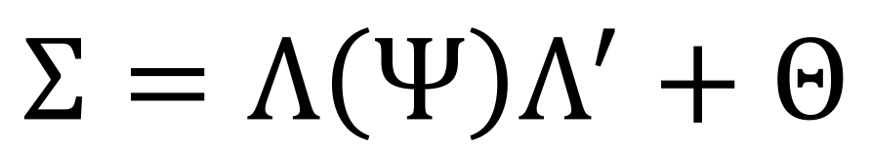
Why Am I Telling You All of This?
What your (simpler) model says the variances/covariances should be (i.e., model-implied)
$$Σ=Λ\left(Ψ\right)Λ^{′}+Θ$$
Comparing
these is how
we appraise
model fit!!!
S
What your actual variances/covariances are (i.e., observed)

Slide 22

Model Fit: S vs. $Σ$
S: Observed (Co)Variances
Σ: Model-implied (Co)Variances
 | Item1 | Item2 | Item3 | Item4 | Item5 | Item6
Item1 | Var₁ | -- | -- | -- | -- | --
Item2 | Cov₁₂ | Var₂ | -- | -- | -- | --
Item3 | Cov₁₃ | Cov₃₂ | Var₃ | -- | -- | --
Item4 | Cov₁₄ | Cov₂₄ | Cov₃₄ | Var₄ | -- | --
Item5 | Cov₁₅ | Cov₂₅ | Cov₃₅ | Cov₄₅ | Var₅
Item6 | Cov₁₆ | Cov₂₆ | Cov₃₆ | Cov₄₆ | Cov₅₆ | Var₆
 | Item1 | Item2 | Item3 | Item4 | Item5 | Item6
Item1 | Var₁ | -- | -- | -- | -- | --
Item2 | Cov₁₂ | Var₂ | -- | -- | -- | --
Item3 | Cov₁₃ | Cov₃₂ | Var₃ | -- | -- | --
Item4 | 0 | 0 | 0 | Var₄ | -- | --
Item5 | 0 | 0 | 0 | Cov₄₅ | Var₅
Item6 | 0 | 0 | 0 | Cov₄₆ | Cov₅₆ | Var₆

Slide 23
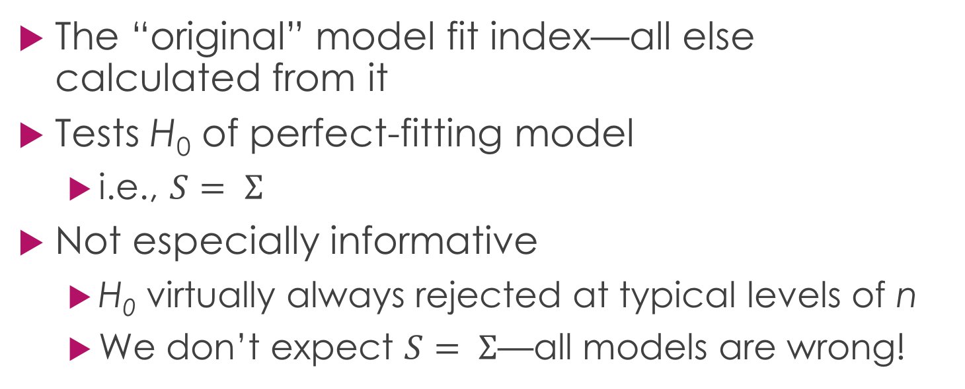
Evaluating Model Fit: The χ² test
The “original” model fit index—all else calculated from it
Tests H₀ of perfect-fitting model
i.e., $S= Σ$
Not especially informative
H₀ virtually always rejected at typical levels of n
We don’t expect $S= Σ$—all models are wrong!

Slide 24
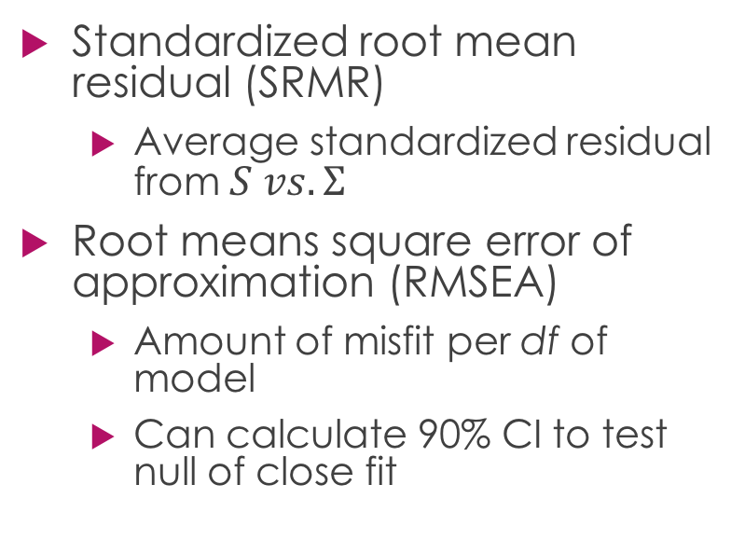
Evaluating Model Fit: Absolute Indexes
Standardized root mean residual (SRMR)
Average standardized residual from $S vs.Σ$
Root means square error of approximation (RMSEA)
Amount of misfit per df of model
Can calculate 90% CI to test null of close fit
Worst
Fit
Our
Model
Perfect
Fit
Absolute
Indexes
> .10 (poor); .08-.10 (mediocre); .05-.08 (acceptable); .01-.05 (close); .00 (perfect)

Slide 25
Evaluating Model Fit: Relative Indexes
Compare our model to “null” model
Reasonable “worst-fitting” model
Worst
Fit
Our
Model
Perfect
Fit
Relative
Indexes

Slide 26
Evaluating Model Fit: Relative Indexes
Σ: “Null” Model
Σ: Our Model
 | Item1 | Item2 | Item3 | Item4 | Item5 | Item6
Item1 | Var₁ | -- | -- | -- | -- | --
Item2 | 0 | Var₂ | -- | -- | -- | --
Item3 | 0 | 0 | Var₃ | -- | -- | --
Item4 | 0 | 0 | 0 | Var₄ | -- | --
Item5 | 0 | 0 | 0 | 0 | Var₅
Item6 | 0 | 0 | 0 | 0 | 0 | Var₆
 | Item1 | Item2 | Item3 | Item4 | Item5 | Item6
Item1 | Var₁ | -- | -- | -- | -- | --
Item2 | Cov₁₂ | Var₂ | -- | -- | -- | --
Item3 | Cov₁₃ | Cov₃₂ | Var₃ | -- | -- | --
Item4 | 0 | 0 | 0 | Var₄ | -- | --
Item5 | 0 | 0 | 0 | Cov₄₅ | Var₅
Item6 | 0 | 0 | 0 | Cov₄₆ | Cov₅₆ | Var₆
Compare each to S to get χ² for each

Slide 27
Evaluating Model Fit: Relative Indexes
Compare our model to “null” model
Reasonable “worst-fitting” model
Recommended:
Tucker-Lewis Index (TLI)/Non-Normed Fit Index (NNFI)
Comparative Fit Index (CFI)
Worst
Fit
Our
Model
Perfect
Fit
Relative
Indexes
< .95(poor); .85-.90 (mediocre); .90-.95 (acceptable); .95-.99 (close); 1.00 (perfect)

Slide 28
Recommendations for Evaluating Model Fit
Hu & Bentler (1999)
Recommend two-index evaluation strategy: χ² + 1 absolute index + 1 relative index
Take note when similar indexes radically diverge

Slide 29
But There’s A Problem or Two…
Scale-setting: Latent variables are “unobservable”–how do we come to understand their scale? We need a reference point of some kind.
Identification: Many unknowns to solve for. We need to ensure the equations for the model are solvable.

Slide 30
Scale-Setting and Identification Methods
Fix an estimate for every factor to a particular meaningful value; defines latent scale, and makes equations solvable
“Marker-variable”: fix a loading for each factor to 1 (the default of most SEM software)
Privileges marker-variable as “gold-standard”, introduces problems later—best avoided
“Fixed-factor”: fix latent variance of each factor to 1
Standardizes the latent variable—should be your go-to

Slide 31
CFA in lavaan()
Save CFA model syntax in an R object
Fit CFA model and specify scale-setting method; save output in a new object
Request summary output from CFA object

Slide 32
What, Then?
If a preselected model fits well…
Congrats: you saved yourself the time/money/participants to collect a new sample
If a preselected model doesn’t fit well…
Time to turn to the data to help inform our theorizing, by using EFA

Slide 33
Step 2: Theory-Building with EFA

Slide 34
Background of Exploratory Factor Analysis
Like CFA, but indiscriminant pattern of factor loadings
We estimate a loading for every item on every factor
Many analytic options to specify
Flexibility is great, but easy to get overwhelmed with all choices

Slide 35
The Three Analytic “Phases” of EFA
Estimation/Extraction
What algorithm will be used to determine values for factor loadings, error variances, latent correlations, etc.,
Retention
How many factors are necessary to retain?
Rotation
How should >1 Factor solutions be oriented in multidimensional space
Spoiler: your software defaults to worst options for all three

Slide 36
Phase 1—Estimation: Choosing Between two Teams
Principal Components Analysis
Default of most factor analysis software
Components not meant to be theoretically meaningful constructs—just simple linear reductions
Assumes all items measured without error
Common Factor Analysis
Many subtypes (e.g., maximum likelihood)
Intended to uncover theoretically meaningful latent variables
Does not make assumptions about error variance in items

Slide 37
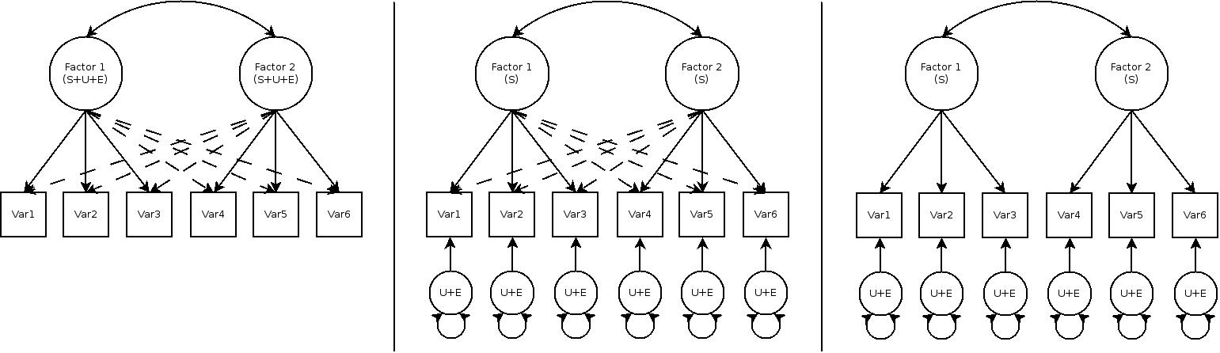
Distinguishing Between PCA, EFA, and CFA Models (see Sakaluk & Short, 2016)
Principal Components
Common Factor EFA
Confirmatory Factor Analysis
Why the $%*& would you choose this…
…if you’re eventually going to do this?

Slide 38
Devil in the Details: How Are PCA and Common Factor Different?
PCA correlation matrix
Common Factor correlation matrix
 | Item1 | Item2 | Item3 | Item4 | Item5 | Item6
Item1 | 1 | -- | -- | -- | -- | --
Item2 | Cor₁₂ | 1 | -- | -- | -- | --
Item3 | Cor₁₃ | Cor₃₂ | 1 | -- | -- | --
Item4 | Cor₁₄ | Cor₂₄ | Cor₃₄ | 1 | -- | --
Item5 | Cor₁₅ | Cor₂₅ | Cor₃₅ | Cor₄₅ | 1
Item6 | Cor₁₆ | Cor₂₆ | Cor₃₆ | Cor₄₆ | Cor₅₆ | 1
 | Item1 | Item2 | Item3 | Item4 | Item5 | Item6
Item1 | R²₁ | -- | -- | -- | -- | --
Item2 | Cor₁₂ | R²₂ | -- | -- | -- | --
Item3 | Cor₁₃ | Cor₃₂ | R²₃ | -- | -- | --
Item4 | Cor₁₄ | Cor₂₄ | Cor₃₄ | R²₄ | -- | --
Item5 | Cor₁₅ | Cor₂₅ | Cor₃₅ | Cor₄₅ | R²₅
Item6 | Cor₁₆ | Cor₂₆ | Cor₃₆ | Cor₄₆ | Cor₅₆ | R²₆
R² = variance explained
predicting item from every other item (“SMC”)

Slide 39
What Are the Practical Consequences of PCA vs. Common Factor Estimation?
Sometimes they will yield identical results
Only if factor loadings are exceptionally strong
Otherwise PCA is suboptimal—so don’t use it!
Will overestimate loadings (i.e., you will keep bad items)
You will underestimate factor correlations, if you estimate them at all (i.e., you will miss out on important theoretical associations between your factors).

Slide 40
Phase 2—Factor Retention: How Many Factors to Keep?
Worth asking: Why is it important to get it right?
Too few: you leave important item variance/theoretical information on the table
Too many: you introduce redundancy in your factors, leading to multicollinearity issues later
Again: most software defaults to least helpful retention criteria

Slide 41
The Unhelpful (but Most Commonly Reported) Criteria for Factor Retention
% Variance explained
Inflated w/ PCA; won’t sum to 100% w/ common factor
How much is/isn’t meaningful?
Eigenvalue > 1 Rule/ “Kaiser Criterion”
Developed/only meaningful for PCA
Totally arbitrary—why keep 1.01 but ditch 0.99?
The Scree Test/Plot
Highly subjective—can be very ambiguous
Can be accurate, but only with very strongly defined factors

Slide 42
The More-Helpful Criteria for Factor Retention
Parallel Analysis
Simulation technique—scree test on steroids
Absolute/Relative Indexes of Model Fit
Yes. The very same ones as in CFA. Require ML estimation
Nested Model Comparisons (i.e., Δχ² tests)*
Do more complicated models (i.e., more factors) significantly improve fit to data?
*See easy-to-use Excel spreadsheet in Sakaluk & Short (2016) supplemental materials

Slide 43
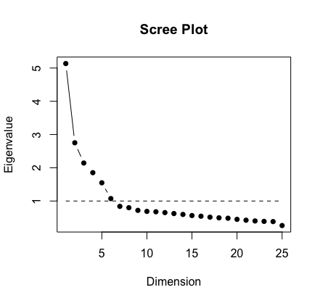
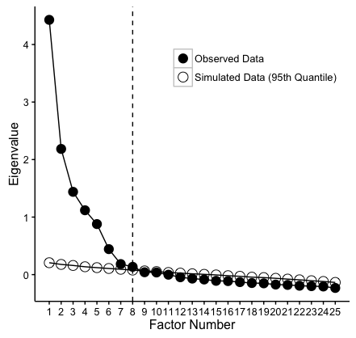
Scree Test vs. Parallel Analysis
Scree Test
Parallel Analysis

Slide 44
It’s Not All About the Numbers: Theory and Interpretability
Don’t let the numbers “handcuff” you—at least at this stage
Pick a solution that is empirically tenable, but among those, remember that you are in charge

Slide 45
Phase 3—Factor Rotation: Orienting Factor Solutions in Multidimensional Space
Multi-factor EFA solutions are “indeterminate”
Infinite # of equally well-fitting solutions, oriented differently in multidimensional space
How to choose among them?
Thurstone’s principle of “Simple Structure” via rotation
Translation: discriminating pattern of factor loadings (items shouldn’t load onto every [not multiple] factor)
Should make for easier interpretation of factors
Should be more replicable
SURPRISE: software defaults to worst rotation methods

Slide 46
Two Types of Rotation Strategies—and Myths About Them
Orthogonal rotation (e.g., varimax)
Assumes factors are uncorrelated
Myth: does not “make” factors uncorrelated
Oblique rotation (e.g., oblimin, promax, etc.,)
Estimates correlations between factors
If correlations are 0, will look like an orthogonal solution
Myth: oblique solutions have worse simple structure
Simple structure of oblique solution better when correlations >0

Slide 47
Notes on Preliminary Model Refinement
Retaining/culling items
A cautionary note on arbitrary cutoffs for “important” factor loading values (e.g., .32)
Select items from the breadth of construct space, and avoid redundancy
Highest-loading not always better
Removing cross-loading items can result in lost theoretical nuance

Slide 48
Step 3: In-Depth Theory Testing with CFA

Slide 49
Testing Your Model with a New Sample (!!!)
Good news!
You already know how to do it
Bad news…
More is personally “riding” on the outcome
Consider pre-registering your data analysis strategy to avoid temptation of p-hacking

Slide 50
If Your CFA Model Fit Is Unacceptably Bad…
Tread carefully!
Any model revisions are now exploratory
You will be tempted to justify *anything*
Replication is a must
Software will produce “mod indexes” on request
What model changes in current sample would improve model fit the most

Slide 51
On the Abuse of Correlated Error Variances in Post-Hoc CFA Model Revision
Arguably most common post-hoc modification made to improve model fit
Often times, theoretically indefensible
And when they are, more often than not, should have been predicted from the start

Slide 52
Example of Defensible/Predictable Correlated Error Variances
Affect
Cog
Oral
PVI
Anal
Oral
PVI
Anal
UF 1
UF 2
UF 3
UF 4
UF 5
UF 6

Slide 53
Evaluating Measurement Generalizability via Invariance Testing
Eventually, you/others may wish to compare groups on structural parameters
Means
Variances
Covariances/correlations
Regression slopes
Such comparisons are only valid if construct(s) being measured is the same for all groups
Assumption still applies even if latent variables not being analyzed (e.g., using a generic t-test)

Slide 54
What Level(s) of Invariance Needed for Valid Group Comparisons?
Level # | Invariance Level | What Constraint(s) Imposed? | Needed for Valid Group Comparisons of…
1 | “Configural”/“Pattern” | Same # of factors, and same pattern of items loading onto factors | All structural parameters
2 | “Weak”/ “Loading”/ “Metric” | 1 + equivalent factor loadings | Variances, covariances, and regression slopes
3 | “Strong”/“Intercept” | 1 + 2 + equivalent intercepts | Means

Slide 55
How to Evaluate Measurement Invariance?
Two strategies:
Same Δχ² testing process
ns difference = invariance level supported
ΔCFI (see Cheung & Rensvold, 2002)
Invariance supported if ΔCFI < .01

Slide 56
In-Depth Theory Testing via CFA in R
Fit CFA model inspired from EFA in Sample 1
Request mod indexes if necessary
Use semTools() package for easy testing of measurement invariance

Slide 57
Step 4: Evaluating Validity with SEM

Slide 58
From CFA to SEM
Analytic focus on structural level of the model
Latent means, correlations, specifying regression pathways, etc.,
Can start incorporating observed/latent variables from other measures
Look at correlations/regressions for evaluating construct validity
Major perk of SEM: bigger effect sizes/more statistical power

Slide 59
SEM Considerations
Scale-setting method matters
#1 reason marker-variable sucks: biases results of significance testing of structural estimates involving the latent variable; USE FIXED-FACTOR!
Parcelling items for your factors/other factors
Average groups of items for a given factor into three “parcels”; use parcels, not items as indicators of latent variable

Slide 60
Parcelling Example
Factor 1
Factor 1
Item 1
Item 2
Item 3
Item 4
Item 5
Item 6
Parcel1 (Item1+2)
Parcel2 (Item 3+4)
Parcel3 (Item 5+6)
UF 1
UF 2
UF 3
UF 4
UF 5
UF 6
UF 1
UF 2
UF 3

Slide 61
More on Parcelling
Parcelling helps improve model fit
More reliable than individual indicators
Reduces complexity of measurement model
Ensures locally “just identified” factors
Only do after your full measurement model is tested/supported
Results are sensitive to choice of how to create parcels—consider preregistering analysis strategy

Slide 62
Structural Equation Modeling via R
Fit measurement model for all variables to-be analyzed (parcelling, if necessary)
Specify correlations/regressions involving factors with validity-related variables

Slide 63
Step 5: Deeper/Alternative Understandings via IRT and LCA

Slide 64
Item Response Theory (IRT)
An alternative latent variable modeling approach
More of an item-level focus than EFA/CFA/SEM
Fit an IRT model for each factor’s items:
Evaluate how well each item discriminates between those high/low on factor
Determine amount of information captured by each item/total scale

Slide 65
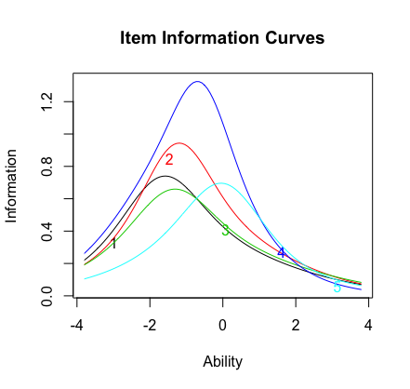
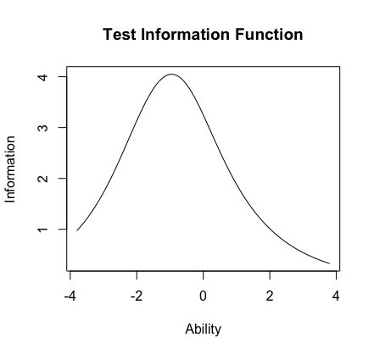
Example: Conscientiousness Items/Scale

Slide 66
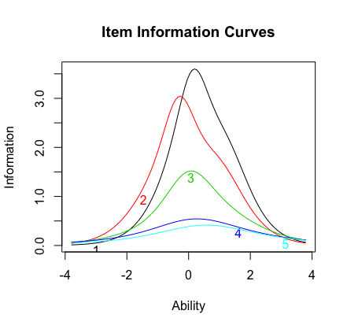
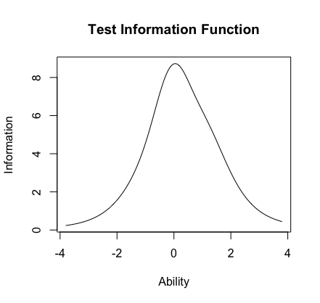
Example: Conscientiousness vs. Neuroticism
Conscientiousness
Neuroticism

Slide 67
Latent Class Analysis (LCA)
EFA/CFA/SEM used to analyze continuous latent variables
LCA used to analyze categorical latent variables
LCA models are more demanding
Require much larger n; lose df very quickly
More difficult to evaluate fit, and analyze alongside other variables
Determining continuous vs. categorical representation is incredibly complicated (see Fraley et al., 2011)

Slide 68
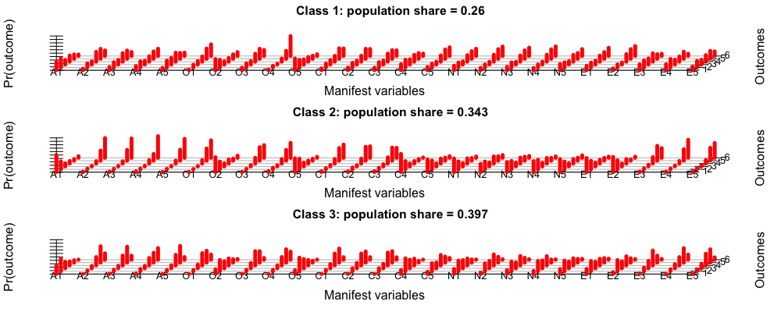
Example LCA Output: Item Response Probabilities for 3 Classes

Slide 69
What Next?

Slide 70
Resources for You
See selected list of references for latent variable analysis
Most informed this talk
StackExchange and CrossValidated
Online Q&A communities for programming and stats
PsychMAP and Psychological Methods Discussion FB Groups
Twitter

Slide 71
Thank You!
And good luck!

